Slide 1
MICROECONOMICS
(BCS 2002-8 )
SPRING-2024
Dr. S. Ghiasul Haq ghiasul786@gmail.com

Slide 2
TOPICS:
Consumer Behavior
Indifference Curve Analysis
Assumptions of Indifference Curve Analysis
Indifference Curve Schedule & Curve
Marginal Rate of Substitution
Indifference Curves Map
Properties of Indifference Curves
Budget Line & Consumer Equilibrium
Limitations Indifference Curve Model
Conclusion

Slide 3
(A) INDIFFERENCE CURVE ANALYSIS
LEARNING OBJECTIVES:
Describe the purpose, use, and properties of indifference curves
Understand how indifference curves differs from another.
Understand how to find the consumer equilibrium using indifference curves with a budget constraint
Limitations indifference curve analysis

Slide 4
(B) CONSUMER BEHAVIOR
CONSUMER BEHAVIOR is the study of individual customers, organizations, or groups’ behavior while selecting, purchasing, using, and disposing of the goods, ideas, and services so they can meet their wants and needs. In simple terms, consumer behavior is the study of consumers’ actions and reactions in the marketplace and the reason behind their actions.
The concepts of Utility and Indifference Curves are two main instruments for analyzing the consumer behavior in economic perspective.
Note: [The utility Analysis part of Consumer Behavior has been discussed under different topics of Lecture-5]

Slide 5
( C-1)INDIFFERENCE CURVE ANALYSIS
Definition:
The indifference curve approach was introduce by Hicks & Allen. As against the Cardinal Concept of Utility Analysis , it indirectly measures the utility by ranking different combinations goods ranked according to the preferences of buyer Ordinally
An indifference curve is a graph showing combination of two goods that give the consumer equal satisfaction and utility. Each point on an indifference curve indicates that a consumer is indifferent between the two and all points give him the same level of utility. In other words, the consumer would be indifferent to these different combinations.
Example of choice of goods which give consumers the same utility

Slide 6
…. (C-2) Assumptions of Indifference Curve Analysis
Rationality of Consumer :The Consumer is Rational & aims at maximizing his total Satisfaction.
(2) Ordinal Utility: Utility can be expressed Ordinally
i.e. Consumer is able to tell only Order of his
Preferences.
(3) Limited Supply: Consumer is not Oversupplied with
Goods in question.
(4) Transitivity of Choice: Means that if a Consumer
prefers A to B & B to C, he must prefer A to C.

Slide 7
…. (C-3) Assumptions of Indifference Curve Analysis
5) Consistency of Choice: Means that if a Consumer prefers A to B in one period, he will not prefer B to A in another period or Treat them as Equal.
(6) Diminishing Marginal Rate of Substitution (MRS): As an individual substitute the product X for product Y. the MRS continuously declines due o less availability of In other words the consumer is less and less inclined to sacrifice X for Y. (It is due this property the Indifference Cure is always Convex to its Origin). (To be discussed with further details)

Slide 8
(C-4) Indifference Curve Schedule
An Indifference Curve Schedule refers to a Schedule that Indicates different Combinations of Two Commodities which yield Equal Satisfaction
(Graph - Next Slide)
Combination | Apples | Oranges
A | 1 + | 10
B | 2 + | 7
C | 3 + | 5
D | 4 + | 4

Slide 9
…(C-4) Indifference Curve
Indifference Curve (IC) is a Diagrammatic Representation of Indifference Schedule.
IC It is a line that shows all possible Combinations of Two Goods between which a person is
Indifference Curve
Oranges
Apples

Slide 10
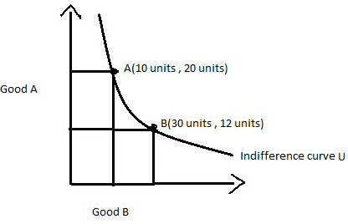
….( D-5) Indifference Curve
Indifference Curve-Further Description:
Graphically, the indifference curve is a downward sloping convex to the origin showing a combination of two goods that the consumer consumes
The graph shows the Utility Indifference Curve showing bundles of goods A and B.
To the consumer, bundle A and B are the same as both of them give him equal satisfaction.
In other words, point A gives as much utility as point B to the individual. The consumer will be satisfied at any point along the curve assuming that other things are constant.

Slide 11
(E) Marginal Rate of Substitution
The Rate at which an Individual must give up “Good A” in order to obtain One More Unit of “Good B”, while keeping their Overall Utility (Satisfaction) Constant. The Marginal Rate of Substitution (MRS) is Calculated between Two Goods placed on an Indifference Curve, which displays a Frontier of Equal Utility for Each Combination of “Good A” and “Good B”
MRS Keeps on Declining since Consumer has more & more units of one Good, he gives up Less Units of Other Good
Continued next slide

Slide 12
(E) Marginal Rate of Substitution
There are different ways to define the Marginal Rate of Substitution
Definition 1:
It is the maximum rate at which the consumer would be willing to substitute a little more of good x for a little less of good y in order to leave the consumer just indifferent between consuming the old basket or the new basket
Definition 2:
It is the negative of the slope of the indifference curve:
MRS_{x,y} = - dy /dx
Khan Acad:
- Slope of indifference curve = Marginal rate of substitution
How much of the vertical axis youre giving up as an increment of the horizontal axis

Slide 13
,,,,(E) Diminishing Marginal Rate of Substitution
An indifference curve exhibits a Diminishing Marginal Rate of substitution:
The more of good x you have, the more you are willing to give up to get a little of good y.
As result of (1) above the indifference curves:
Get flatter as we move out along the horizontal axis
Get steeper as we move up along the vertical axis.

Slide 14
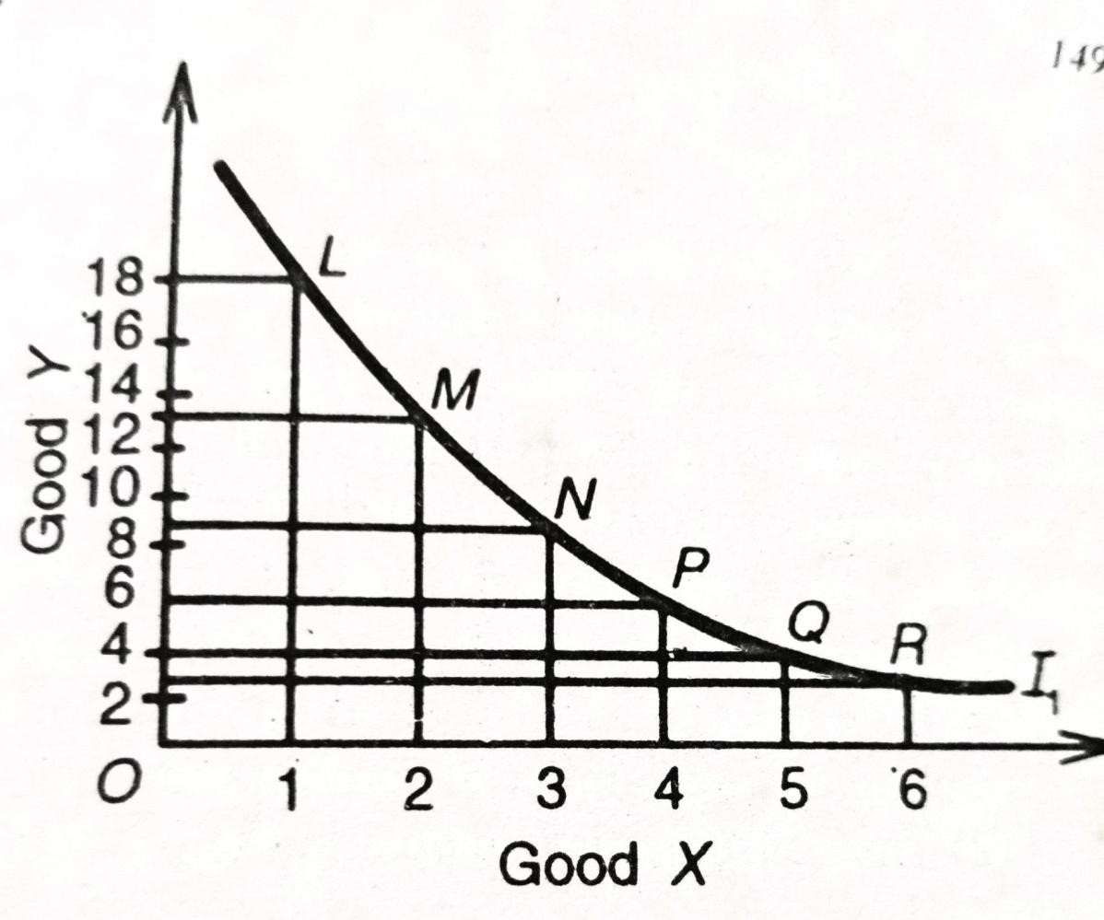
Example: The Diminishing Marginal Rate of Substitution
MARGINAL RATE OF SUBSUTUTION
Combination | Good X | Good Y | MRS of X for Y
L | 1 | 18 | -
M | 2 | 13 | 5:01
N | 3 | 9 | 4:01
O | 4 | 6 | 3:01
P | 5 | 4 | 2:01
Q | 6 | 3 | 1:01

Slide 15
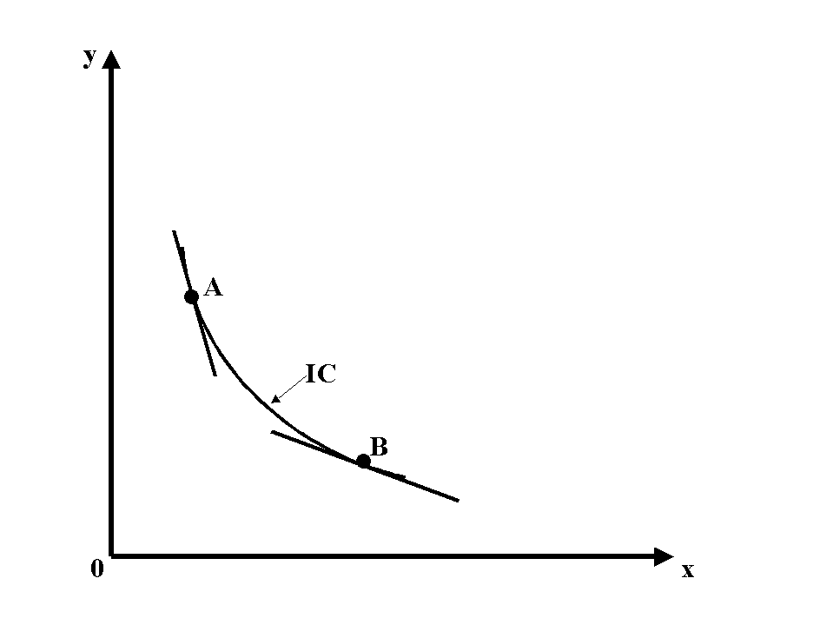
Example: The Diminishing Marginal Rate of Substitution

Slide 16
Example: Marginal Rate of Substitution with Perfect Substitutes (butter and margarine) Constant Marginal rate of Substitution)
Btter
IC₁
0
Margarine

Slide 17
(E) Indifference Curves Map
Good y
(i)An Indifference Map represents a Group of Indifference Curves
each of which expresses a given level of Satisfaction.
(ii)If an indifference curve Shifts to Right, the Level of Satisfaction goes on Increasing. IC4> IC3>IC2)IC1
•
C
IC₄
•
A
IC₃
B
•
IC₂
IC₁
Good x

Slide 18
…E. PROPERTIES OF INDIFFERENCE CURVES
Indifference curves never cross
The farther out an indifference curve lies (i.e. farther is from the origin) – the higher the level of total utility it indicates
Indifference curves slope downward
Indifference curves have a convex shape

Slide 19
…E. INDIFFERENCE CURVES NEVER CROSS
y
Suppose a consumer is indifferent between A and C
Suppose that B is preferred to A.
Continued on Next Slide
IC₁
•
B
•
A
C
•
x

Slide 20
…E. INDIFFERENCE CURVES NEVER CROSS
y
It cannot be the case that an IC contains both B and C
Why? because, by definition of IC the consumer is:
Indifferent between A & C
Indifferent between B & C
Hence he should be indifferent between A & B (by transitivity).
=> Contradiction.
IC₂
IC₁
•
B
•
A
C
•
x

Slide 21
Good y
…E. INDIFFERENCE CURVES MAP
2. The farther out an indifference curve lies – the farther is from the origin – the higher the level of total utility it indicates
Continued on Next Slide
•
C
•
A
IC₃=30
B
IC₂=20
•
IC₁=10
Good x

Slide 22
y
…E. INDIFFERENCE CURVES NEVER CROSPREFERCE DIRECTIONS
The farther out an indifference curve lies – the farther is from the origin – the higher the level of total utility it indicates
Preferred to A
•
A
Less
preferred
IC₁
x

Slide 23
y
Example: … E ..Indifference curve-Preference direction
5
Preference direction
20 = xy
2
10 = xy
0
2
5
x

Slide 24
Good y
E…..The indifference curves slope downward: more is better but if A, B and C are on the same indifference curve, an increase in X must be compensated by a decrease in Y
•
C
•
A
B
•
IC₁=10
Good x

Slide 25
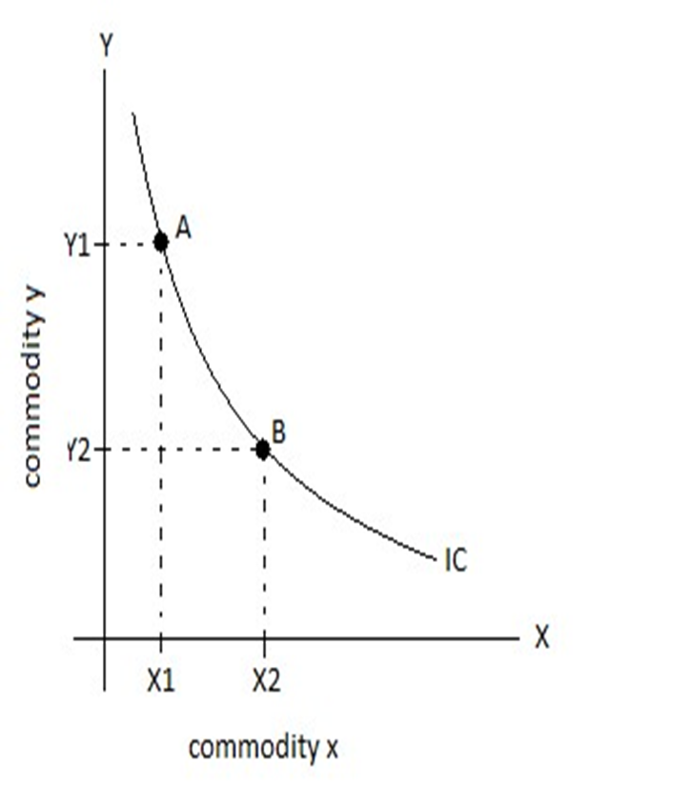
… E. Indifference Curves are convex to origin
Indifference Curves are convex to the point of Origin due to diminishing the marginal rate of substitution of commodities. This implies that as the consumer gets more and more of X he is ready to sacrifice less and less of Y.
(i) steeper slope at A, flatter slope at B; (ii) average bundles are preferred to the extremes

Slide 26
F. BUDGET LINE
Definition: Budget line is a line which shows all combinations of two goods that a consumer can afford with a given income and given prices of commodities. It is also known as price line, consumption possibility line, and line of attainable combinations.
The budget line always by definition has a negative slope.
It indicates a continuous market rate of exchange in individual combinations leading to constant slope of the budget line.
With the increase in income it moves upwards above the previous line and vice versa
With the decrease of price (s) it moves upwards above the previous line and vice versa
Below line -> money saved , above line -> more then income spent, on the line -> all of the income is being spent
(Further explained in next Three Slides)

Slide 27
F…. BUDGET LINE -EXAMPLE
Suppose a consumer has an income of Rs.50000/, and it will be used to buy commodities X and Y.
To derive maximum utility from the said income, only the A,B,C,D,E & F options are available.
.
BUDGET ALLOCATION (000)
Combination | Good X | Good Y | Income
 | (Rs 1000 each) | (Rs 5000 each) | Allocation –in 000)
A | 0 | 10 | (10×0)+(5×10)=50
B | 1 | 8 | (10×1)+(5×8)=50
C | 2 | 6 | (10×2)+(5×6)=50
D | 3 | 4 | (10×3)+(5×4)=50
E | 4 | 2 | (10×4)+(5×2)=50
F | 5 | 0 | (10×5)+(5×0)=50

Slide 28
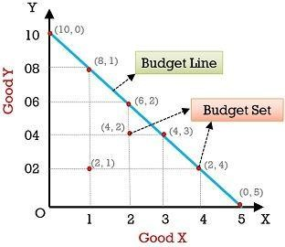
…..F.BUDGET ALLOCATION of Rs.50000
The required budget line is obtained by plotting the Rs. 50000/ budget against the following graph. In the graph, the X-axis represents commodity X, and Y-axis represents commodity Y.

Slide 29
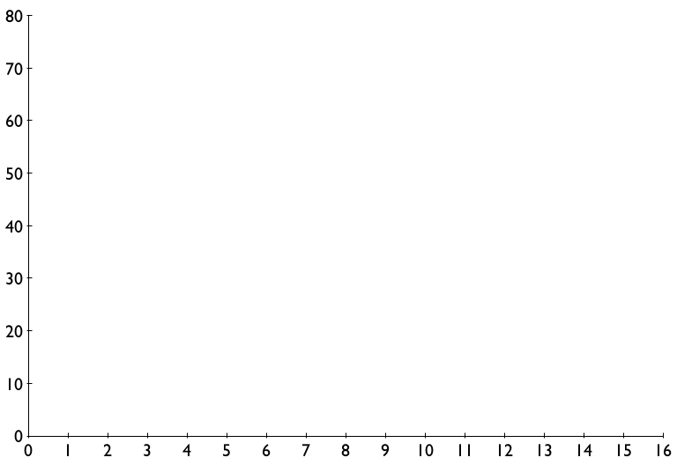
…. F. BUDGET LINE: Increase in Income
Y
An increase in income shifts the
budget line outward.
Income
X

Slide 30
…F. The Budget Line-Decrease in Price of Goo X
Y
If prices change, the slope of the budget line also changes. The slope of the budget constraint equals the amount of Y Consumer can afford if he gives up One X
The price of Good X decreases and now the same budget can buy more of X without reducing the quantity of Good Y
Slope = –2.5
Slope = –5
X

Slide 31
(G) CONSUMER EQUIBLIRIUM- Maximization of Utility
As already discussed indifference curve depicts all the combinations of two goods that provide the consumer with equal satisfaction.
Subject to given income and market prices of two goods, the consumer’s equilibrium refers to a situation in which they achieve maximum satisfaction and feel no need to change their position.
When the Budget line is tangent to the indifference curve, a consumer will be in equilibrium, and attain maximum utility from the combination of two bundle of
Continuous Next Slide….

Slide 32
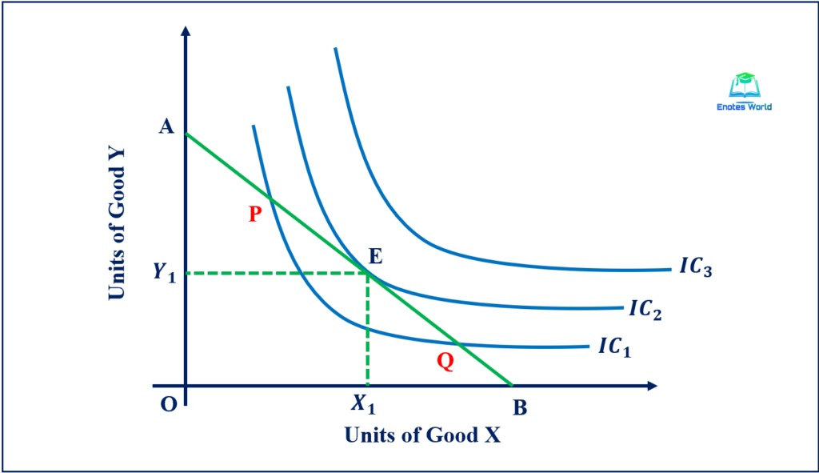
…(G) CONSUMER EQUIBLIRIUM- Maximization of Utility
Given the indifference map of the consumer and his budget line, the equilibrium is defined by the point of tangency of the budget line with the highest possible indifference curve (point E in the fig.)
At the point of tangency the slope of the budget line (Px/Py) and MRSxy= MUx/MUy are equal. The first order condition is fulfilled by the point of tangency of the two relevant curves. The second order condition is implied by the convex shape of the indifference curves.

Slide 33
…(G) CONSUMER EQUIBLIRIUM- Maximization of Utility
A consumer is in equilibrium when he maximizes his utility with his given income and the market prices. Two conditions must be fulfilled for the consumer to be in equilibrium. Movement on either side will shift him to lower Indifference curve. (See figure on previous slide No:33)
MRS_{xy} = MUx/Muy = P_{x}/Py. It means MRS be equal to the ratio of commodity prices. This is a necessary but not sufficient condition for equilibrium.
The indifference curves must be convex to meet the condition of decreasing MRS.

Slide 34
H. Limitations of the Indifference Curve Model
Indifference Curve Analysis is the major Analytical tool of Economics fir analyzing the rationale of Consumer Behavior in making choice among alternative goods. However it has some limitations . Some important limitations ae listed below:
Consumers are presumed to be rational actors, consistently seeking to maximize their utility; disregarding emotional, cultural, and social influences that often impact real-life decisions.
Consumers are assumed to have complete and perfect information about the goods they are choosing from. But in reality consumers often make decisions under uncertainty and with incomplete information, affecting their choices and preferences
CONINUED NEXT SLIDE…..

Slide 35
… H. Limitations of the Indifference Curve Model
Goods are considered divisible into infinitely small units, allowing consumers to choose any quantity. This assumption ignores the fact that many goods are indivisible (e.g., cars, houses) and that this indivisibility can significantly affect consumer choices.
Measuring utility is inherently subjective and difficult to empirically verify limit. This put a limit on the model's practical application in predicting real-world consumer behavior
The model is manageable only with two goods (or two bundle of Goods). Thus while the model, is helpful in understanding general trends in consumer behavior but lacks predictive accuracy when it comes to specific market scenarios due to its over-simplifying assumptions.

Slide 36
CONCLUSION
Indifference curve model is a valuable tool for understanding some basic aspects of consumer choice, but its limitations and assumptions have to be fully understood. Its utility lies in providing a basic rationale about consumer preferences, rather than offering precise predictions about consumer behavior.

